Slide 1
Asymptotic Notation

Slide 2
For large enough inputs, the multiplicative constants and lower-order terms of an exact running time are dominated by the effects of the input size itself.
The extra precision is not usually worth the effort of computing it.
The asymptotic efficiency of algorithms: study input sizes large enough to make only the order of growth of the running time relevant.

Slide 3
We are concerned with how the running time of an algorithm increases with the size of the input in the limit, as the size of the input increases without bound.
Usually, an algorithm that is asymptotically more efficient will be the best choice for all but very small inputs.

Slide 4
The notations we use to describe the asymptotic running time of an algorithm are defined in terms of functions whose domains are the set of natural numbers N = {0, 1, 2, . . .}.
Such notations are convenient for describing the worst-case running-time function T(n), which usually is defined only on integer input sizes.

Slide 5
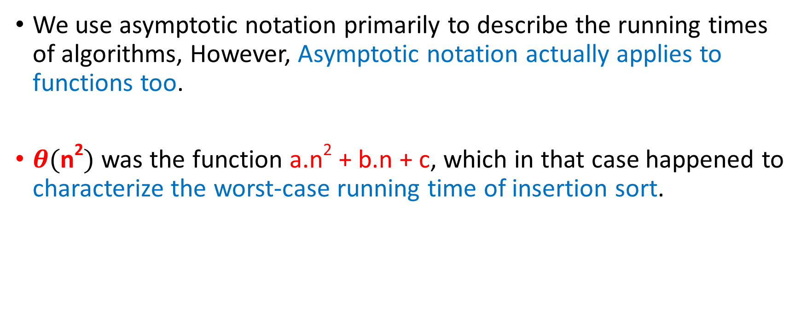
We use asymptotic notation primarily to describe the running times of algorithms, However, Asymptotic notation actually applies to functions too.
$θ(\text{n}\text{2})$ was the function a.n² + b.n + c, which in that case happened to characterize the worst-case running time of insertion sort.

Slide 6
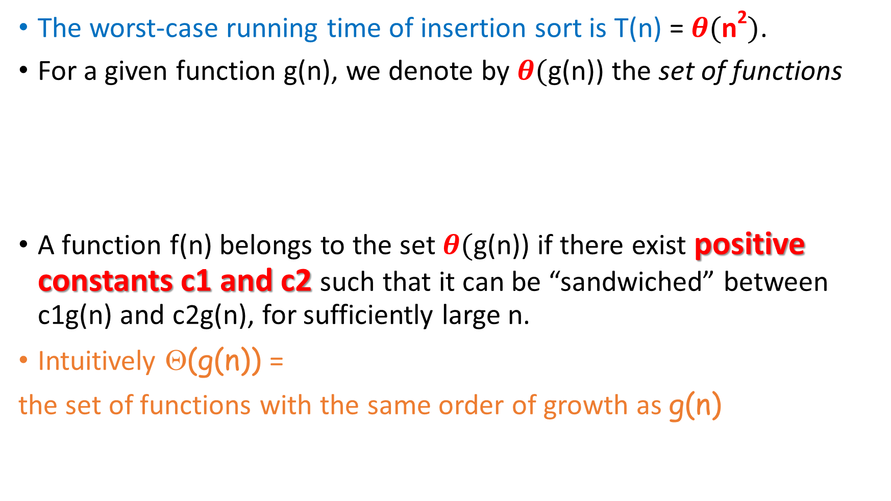
The worst-case running time of insertion sort is T(n) = $θ(\text{n}\text{2})$.
For a given function g(n), we denote by $θ($g(n)) the set of functions
A function f(n) belongs to the set $θ($g(n)) if there exist positive constants c1 and c2 such that it can be “sandwiched” between c1g(n) and c2g(n), for sufficiently large n.
Intuitively Θ(g(n)) =
the set of functions with the same order of growth as g(n)

Slide 7
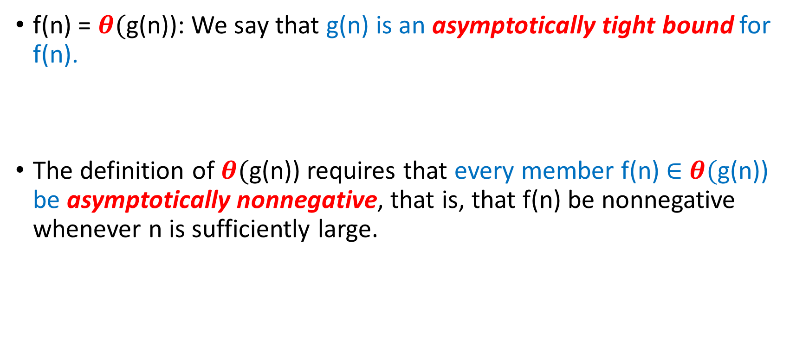
f(n) = $θ($g(n)): We say that g(n) is an asymptotically tight bound for f(n).
The definition of $θ($g(n)) requires that every member f(n) $∈$ $θ($g(n)) be asymptotically nonnegative, that is, that f(n) be nonnegative whenever n is sufficiently large.

Slide 8
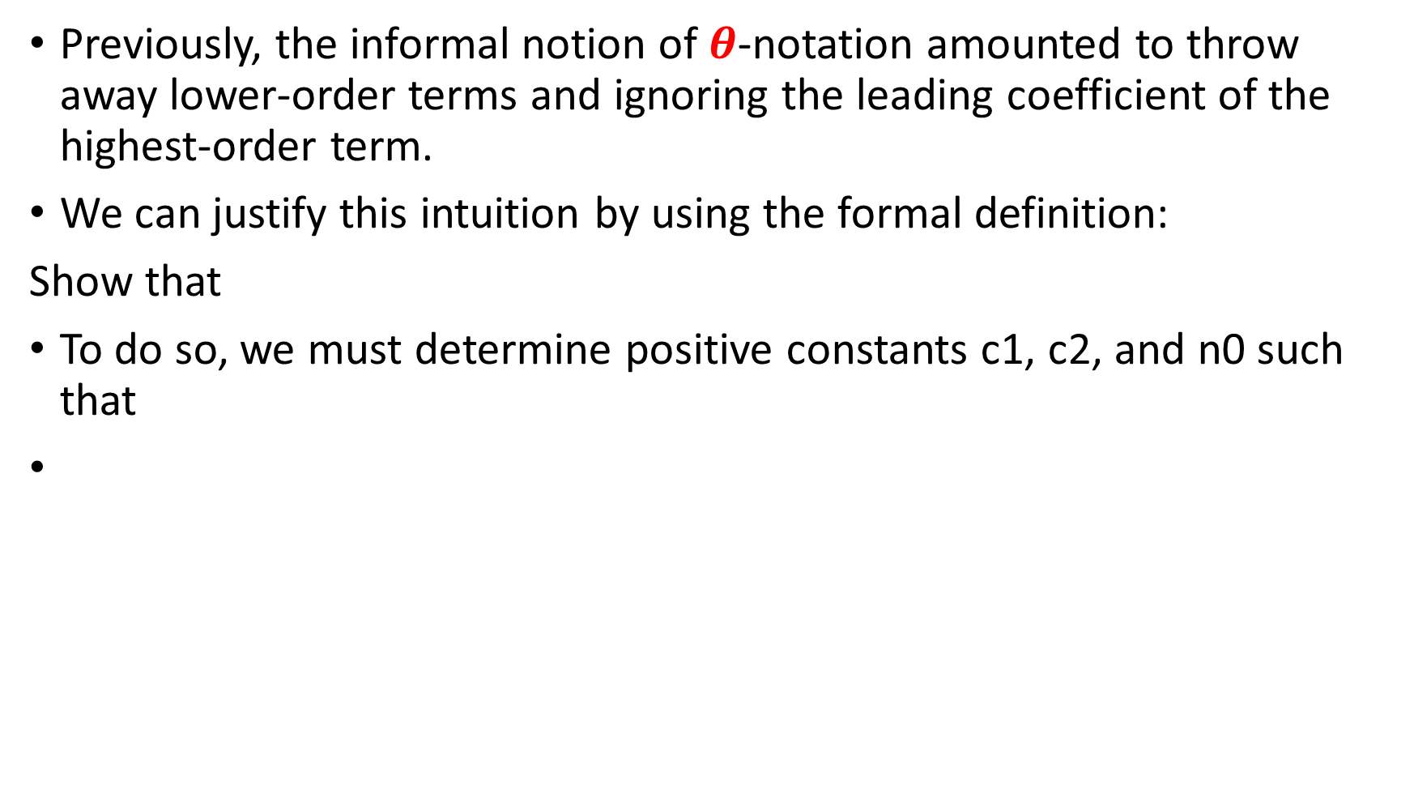
Previously, the informal notion of $θ$-notation amounted to throw away lower-order terms and ignoring the leading coefficient of the highest-order term.
We can justify this intuition by using the formal definition:
Show that
To do so, we must determine positive constants c1, c2, and n0 such that

Slide 9
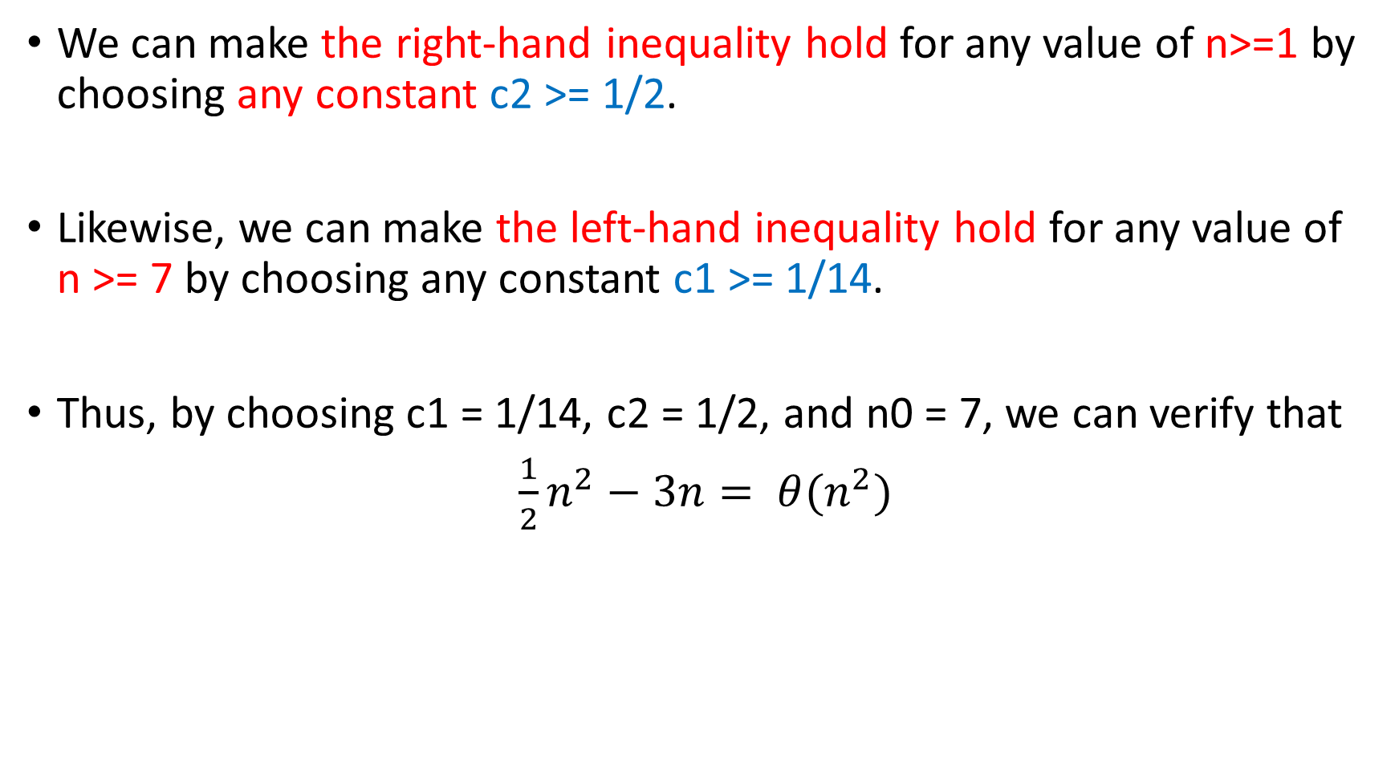
We can make the right-hand inequality hold for any value of n>=1 by choosing any constant c2 >= 1/2.
Likewise, we can make the left-hand inequality hold for any value of n >= 7 by choosing any constant c1 >= 1/14.
Thus, by choosing c1 = 1/14, c2 = 1/2, and n0 = 7, we can verify that
$\frac{1}{2}n^{2}−3n= θ(n^{2})$

Slide 10
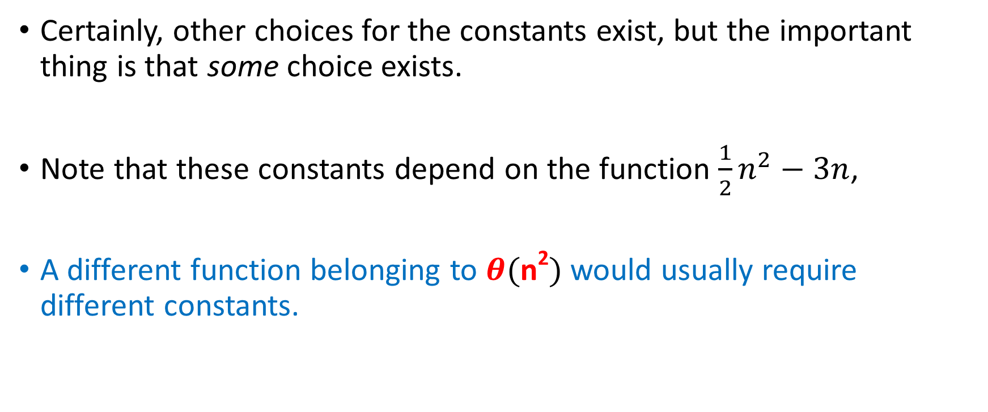
Certainly, other choices for the constants exist, but the important thing is that some choice exists.
Note that these constants depend on the function $\frac{1}{2}n^{2}−3n$,
A different function belonging to $θ(\text{n}\text{2})$ would usually require different constants.

Slide 11
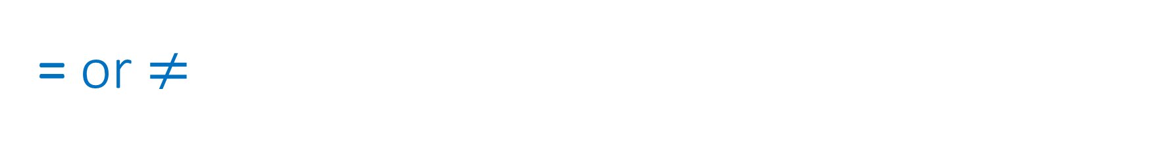

= or $≠$
Verify that 6n³ $≠$ $θ(\text{n}\text{2})$
Hint: can n <= c2/6 possibly hold for arbitrarily large n, since c2 is constant?!
n²/2 –n/2 ___ Θ(n²)
n ___ Θ(n²)
Prove :

Slide 12
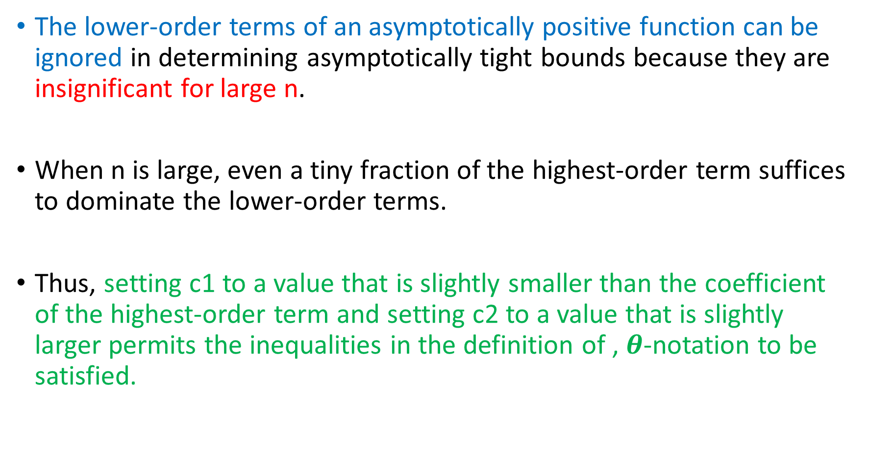
The lower-order terms of an asymptotically positive function can be ignored in determining asymptotically tight bounds because they are insignificant for large n.
When n is large, even a tiny fraction of the highest-order term suffices to dominate the lower-order terms.
Thus, setting c1 to a value that is slightly smaller than the coefficient of the highest-order term and setting c2 to a value that is slightly larger permits the inequalities in the definition of ‚ $θ$-notation to be satisfied.

Slide 13
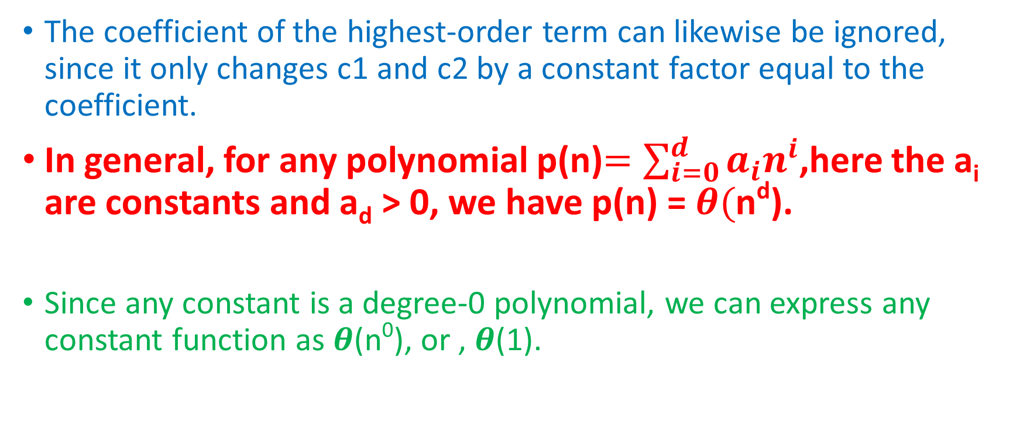
The coefficient of the highest-order term can likewise be ignored, since it only changes c1 and c2 by a constant factor equal to the coefficient.
In general, for any polynomial p(n)$=\sum_{i=0}^{d}{a_{i}n^{i}}$,here the a_{i} are constants and a_{d} > 0, we have p(n) = $θ($n^{d}).
Since any constant is a degree-0 polynomial, we can express any constant function as $θ$(n⁰), or ‚ $θ$(1).

Slide 14
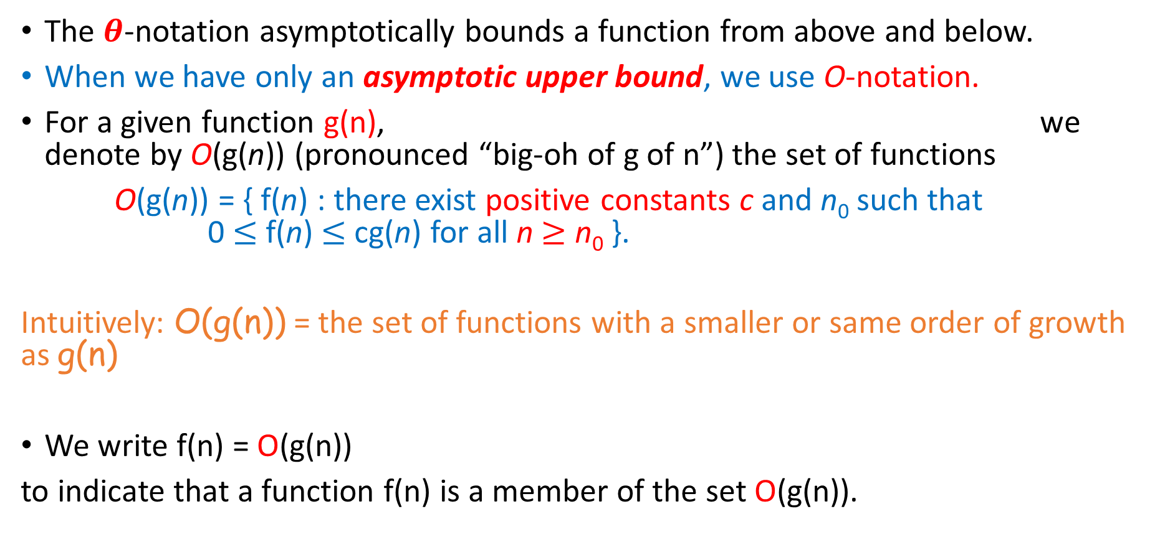
O-notation
The $θ$-notation asymptotically bounds a function from above and below.
When we have only an asymptotic upper bound, we use O-notation.
For a given function g(n), we denote by O(g(n)) (pronounced “big-oh of g of n”) the set of functions
O(g(n)) = { f(n) : there exist positive constants c and n₀ such that 0 $≤$ f(n) $≤$ cg(n) for all n $≥$ n₀ }.
Intuitively: O(g(n)) = the set of functions with a smaller or same order of growth as g(n)
We write f(n) = O(g(n))
to indicate that a function f(n) is a member of the set O(g(n)).

Slide 15
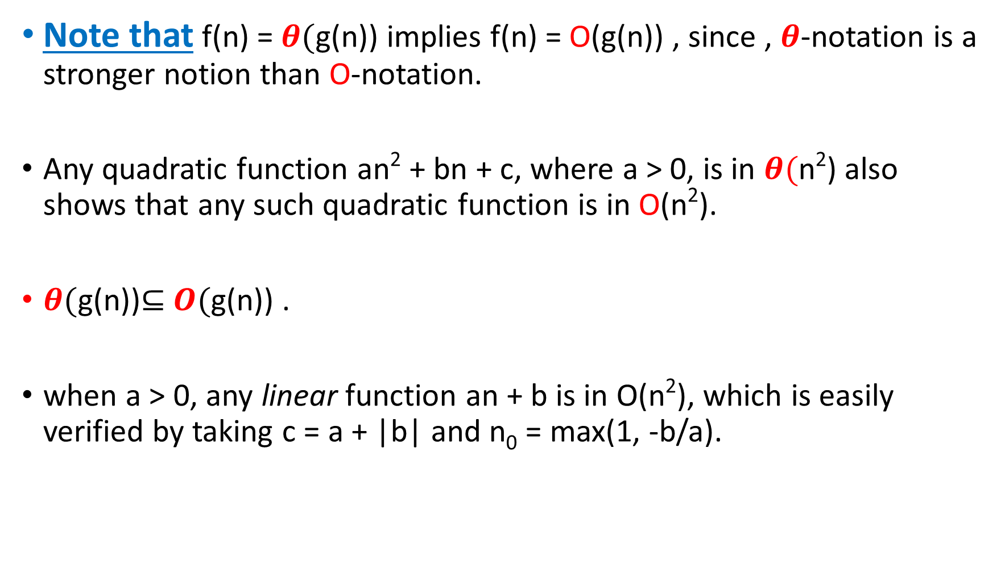
Note that f(n) = $θ($g(n)) implies f(n) = O(g(n)) , since ‚ $θ$-notation is a stronger notion than O-notation.
Any quadratic function an² + bn + c, where a > 0, is in $θ($n²) also shows that any such quadratic function is in O(n²).
$θ($g(n))$⊆$ $O($g(n)) .
when a > 0, any linear function an + b is in O(n²), which is easily verified by taking c = a + |b| and n₀ = max(1, -b/a).

Slide 16
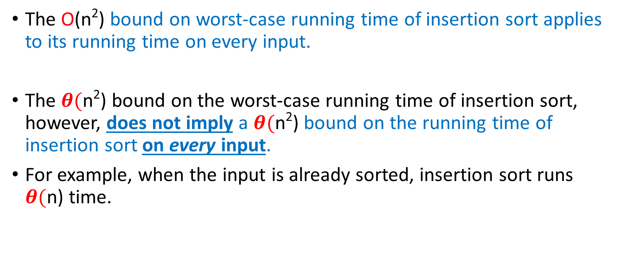
Important Notes
The O(n²) bound on worst-case running time of insertion sort applies to its running time on every input.
The $θ($n²) bound on the worst-case running time of insertion sort, however, does not imply a $θ($n²) bound on the running time of insertion sort on every input.
For example, when the input is already sorted, insertion sort runs $θ($n) time.

Slide 17
= or $≠$
2n² ___ O(n³)
n² ___ O(n²)
1000n²+1000n ___ O(n²)
n ___ O(n²)

Slide 18
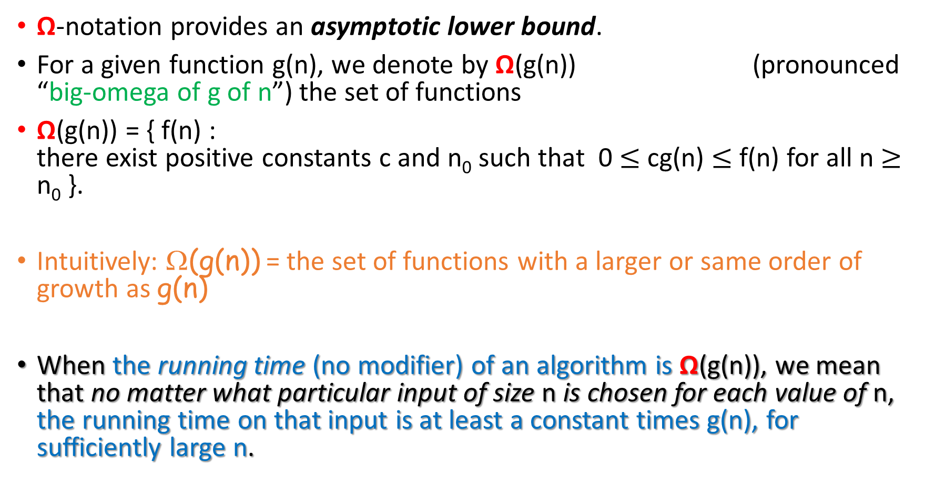
Ω-notation
Ω-notation provides an asymptotic lower bound.
For a given function g(n), we denote by Ω(g(n)) (pronounced “big-omega of g of n”) the set of functions
Ω(g(n)) = { f(n) : there exist positive constants c and n₀ such that 0 $≤$ cg(n) $≤$ f(n) for all n $≥$ n₀ }.
Intuitively: Ω(g(n)) = the set of functions with a larger or same order of growth as g(n)
When the running time (no modifier) of an algorithm is Ω(g(n)), we mean that no matter what particular input of size n is chosen for each value of n, the running time on that input is at least a constant times g(n), for sufficiently large n.

Slide 19
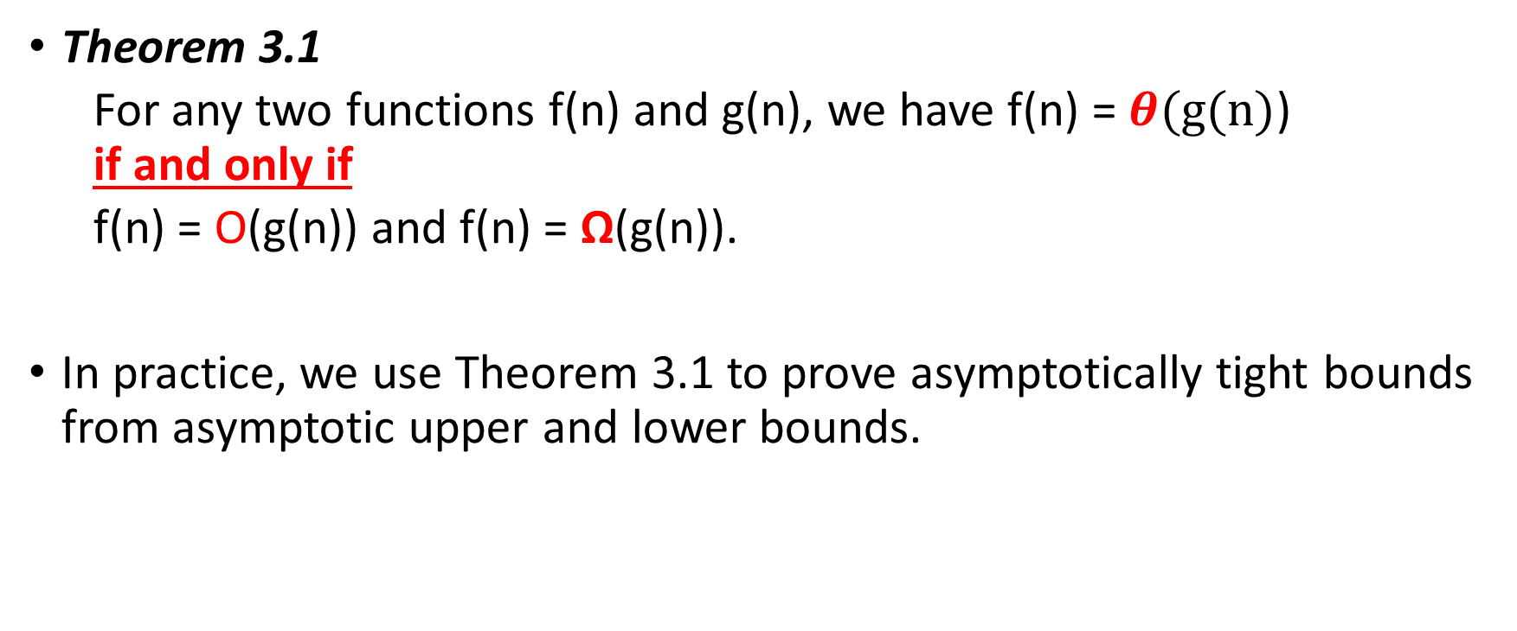
Theorem 3.1
For any two functions f(n) and g(n), we have f(n) = $θ(g(n)$) if and only if
f(n) = O(g(n)) and f(n) = Ω(g(n)).
In practice, we use Theorem 3.1 to prove asymptotically tight bounds from asymptotic upper and lower bounds.

Slide 20
The best-case running time of insertion sort is Ω(n), which implies that the running time of insertion sort is Ω(n).
The running time of insertion sort therefore belongs to both Ω(n) and O(n²), since it falls anywhere between a linear function of n and a quadratic function of n.

Slide 21
= or $≠$
5n² ___ Ω(n)
100n + 5 ___ Ω(n²)
n ___ Ω(2n)
n³ ___ Ω(n²)
n ___ Ω(logn)

Slide 22
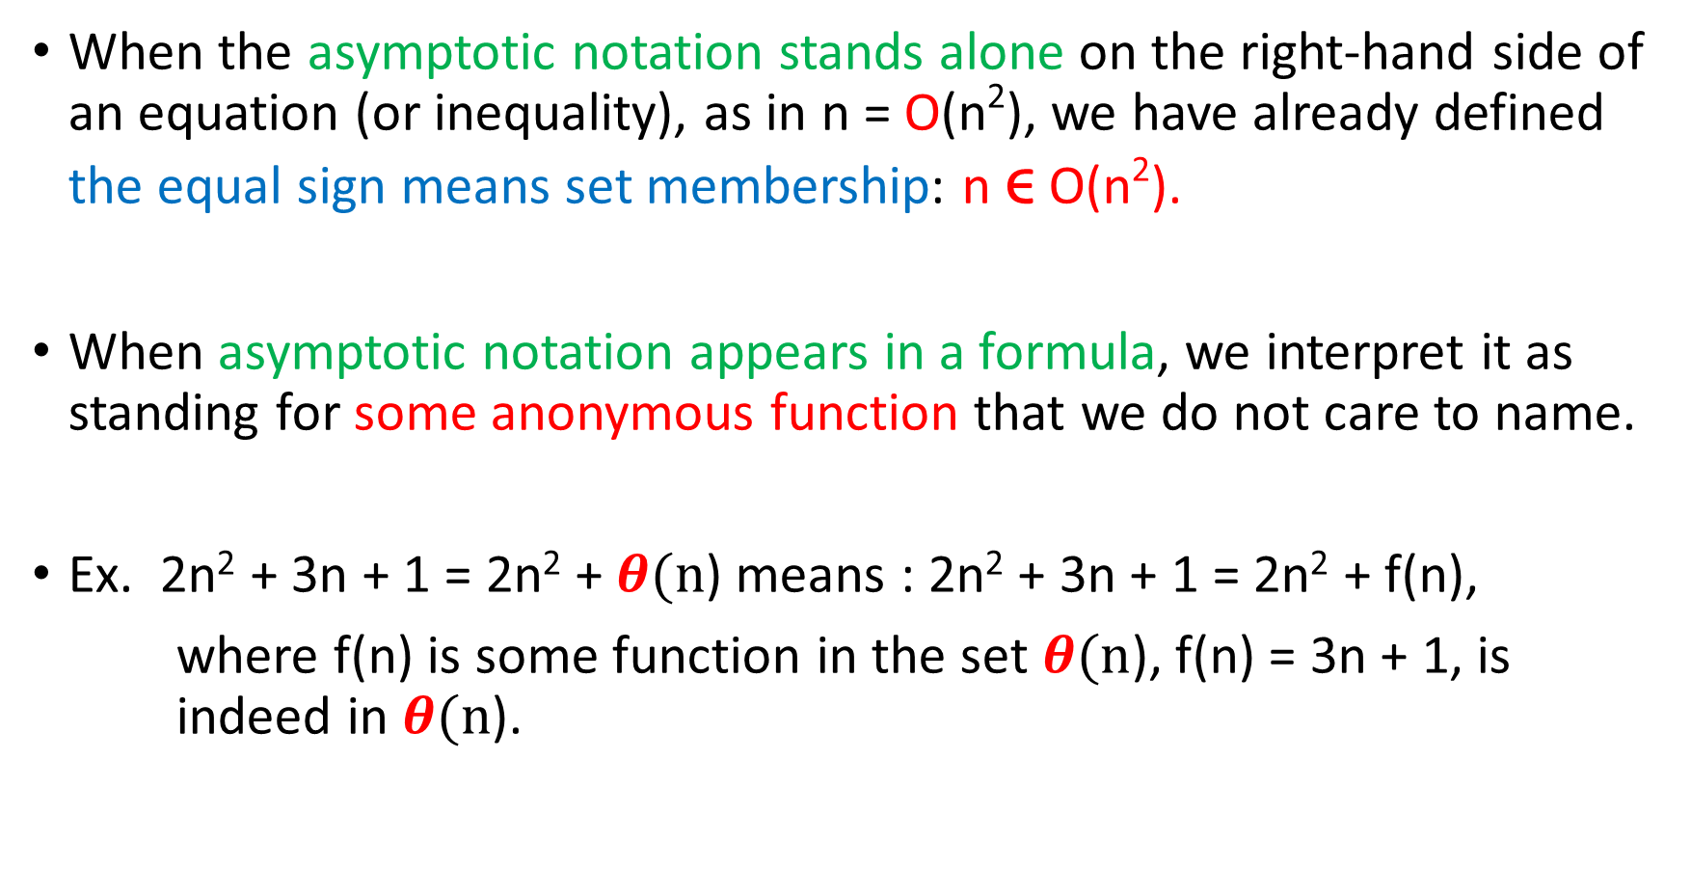
Asymptotic notation in equations and inequalities
When the asymptotic notation stands alone on the right-hand side of an equation (or inequality), as in n = O(n²), we have already defined the equal sign means set membership: n ϵ O(n²).
When asymptotic notation appears in a formula, we interpret it as standing for some anonymous function that we do not care to name.
Ex. 2n² + 3n + 1 = 2n² + $θ(n$) means : 2n² + 3n + 1 = 2n² + f(n),
where f(n) is some function in the set $θ(n$), f(n) = 3n + 1, is indeed in $θ(n$).

Slide 23
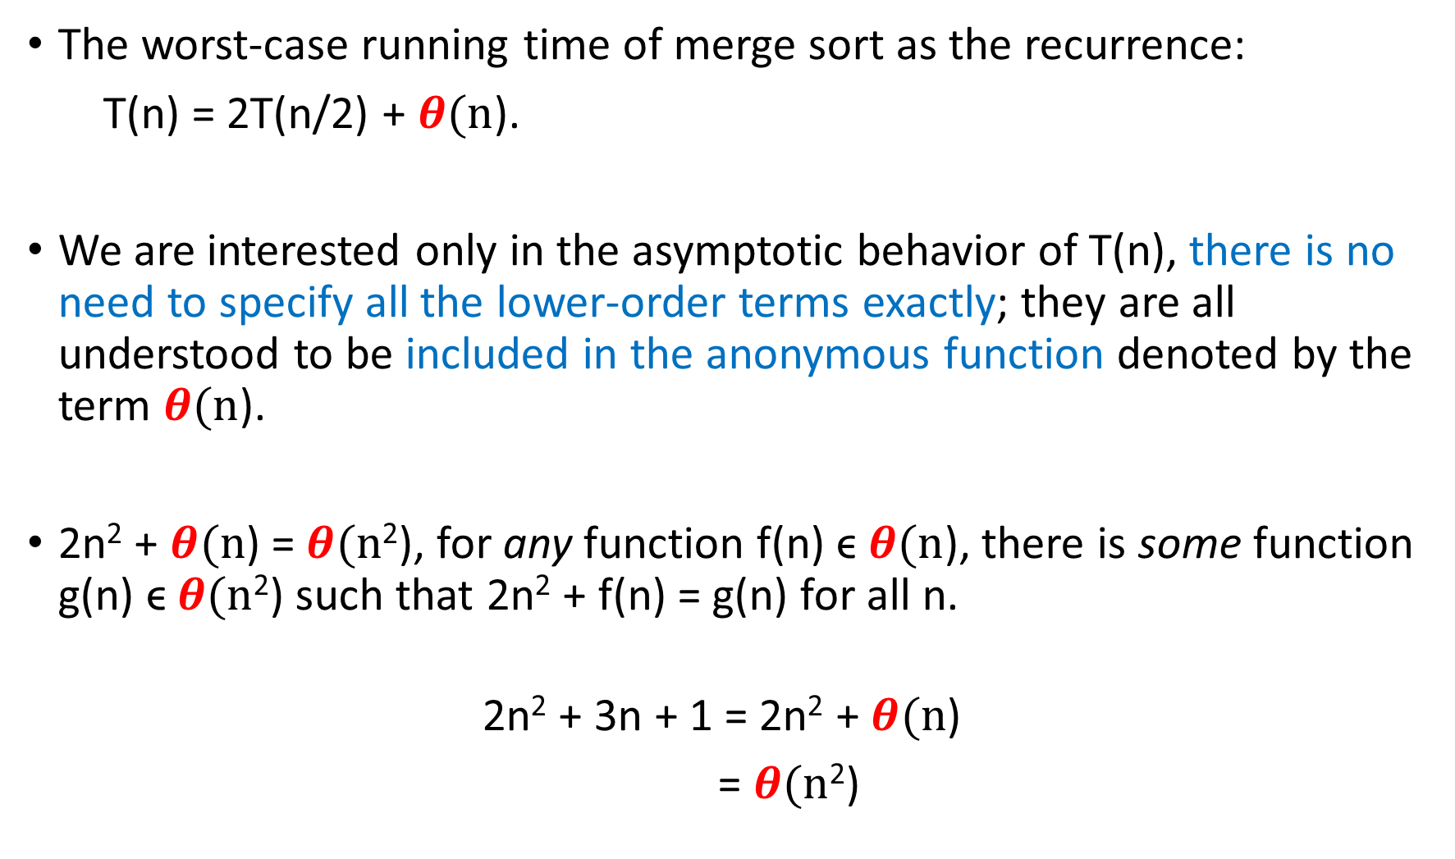
The worst-case running time of merge sort as the recurrence:
T(n) = 2T(n/2) + $θ(n$).
We are interested only in the asymptotic behavior of T(n), there is no need to specify all the lower-order terms exactly; they are all understood to be included in the anonymous function denoted by the term $θ(n$).
2n² + $θ(n$) = $θ(n$²), for any function f(n) ϵ $θ(n$), there is some function g(n) ϵ $θ(n$²) such that 2n² + f(n) = g(n) for all n.
2n² + 3n + 1 = 2n² + $θ(n$)
= $θ(n$²)

Slide 24
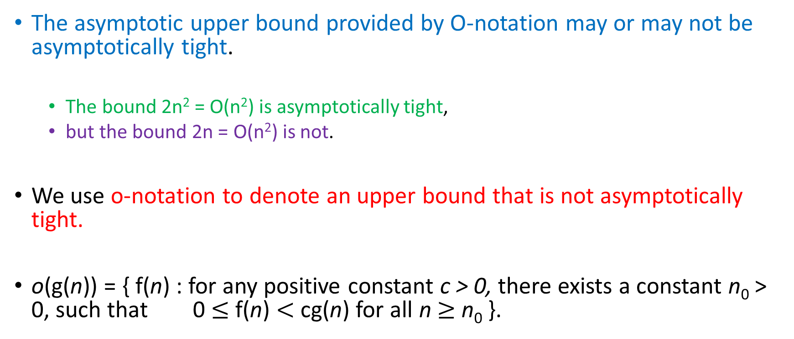
o-notation (little o)
The asymptotic upper bound provided by O-notation may or may not be asymptotically tight.
The bound 2n² = O(n²) is asymptotically tight,
but the bound 2n = O(n²) is not.
We use o-notation to denote an upper bound that is not asymptotically tight.
o(g(n)) = { f(n) : for any positive constant c > 0, there exists a constant n₀ > 0, such that 0 $≤$ f(n) $<$ cg(n) for all n $≥$ n₀ }.

Slide 25

For example, 2n = o(n²), but 2n² $≠$ o(n²).
$\lim_{n→∞}{\frac{f(n)}{g(n)}}$ = 0.

Slide 26
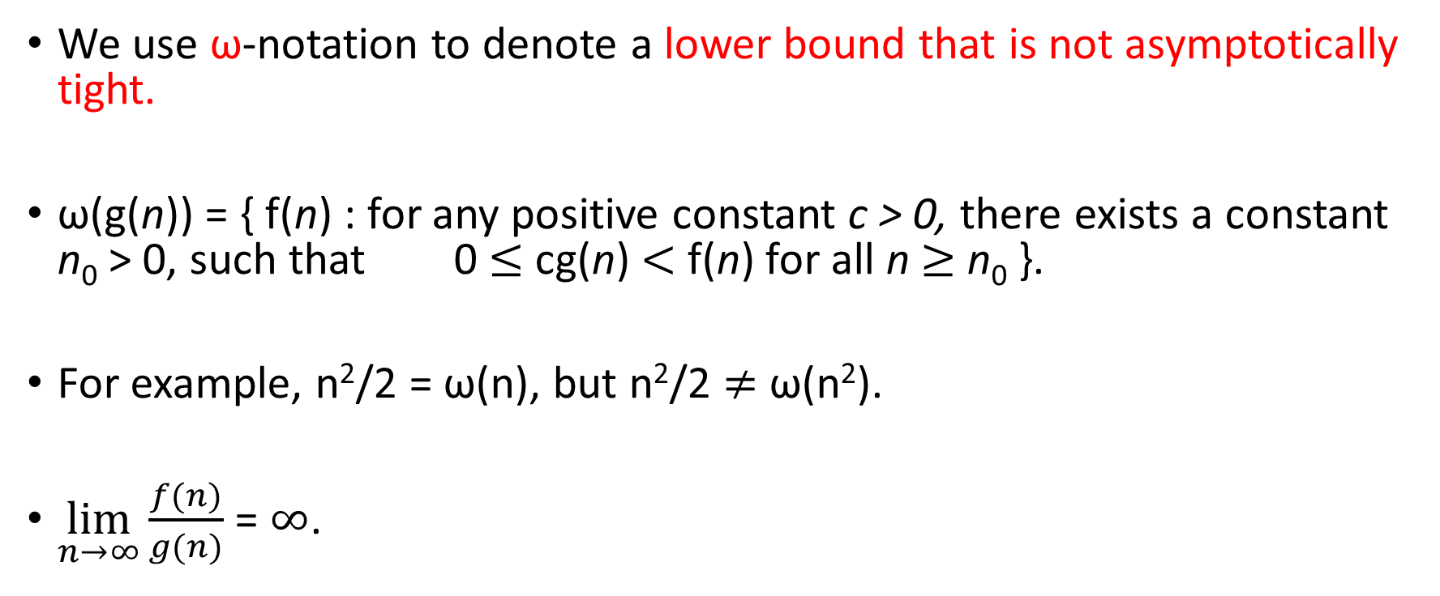
ω-notation (little-omega)
We use ω-notation to denote a lower bound that is not asymptotically tight.
ω(g(n)) = { f(n) : for any positive constant c > 0, there exists a constant n₀ > 0, such that 0 $≤$ cg(n) $<$ f(n) for all n $≥$ n₀ }.
For example, n²/2 = ω(n), but n²/2 $≠$ ω(n²).
$\lim_{n→∞}{\frac{f(n)}{g(n)}}$ = $∞$.

Slide 27
Comparing functions
For the following, assume that f(n) and g(n) are asymptotically positive.

Slide 30
Floors and ceilings

Slide 33
Rule #1: Exponential functions are slower than polynomial functions.
Rule #2: Any positive polynomial function are slower than any polylogarithmic function.

Slide 34
If we hold b > 1 constant, then for n > 0, the function log_{b} n is strictly increasing.

Slide 36
We say that a function f(n) is polylogarithmically bounded if f(n) = O(lg^{k} n)
for some constant k.
Any positive polynomial function grows faster than any polylogarithmic function.

Slide 37
For each of the following pairs of functions, either f(n) is O(g(n)), f(n) is Ω(g(n)), or f(n) is Θ(g(n)). Determine which relationship is correct.
f(n) = log n²; g(n) = log n + 5
f(n) = n; g(n) = log n²
f(n) = log log n; g(n) = log n
f(n) = n; g(n) = log² n
f(n) = n log n + n; g(n) = log n
f(n) = 10; g(n) = log 10
f(n) = 2^{n}; g(n) = 10n²
f(n) = 2^{n}; g(n) = 3^{n}

